Slide 1








Clotho 3.0 Use Cases
Nicholas Roehner and Prashant Vaidyanathan
“Clotho 3.0 Launch Party”
February 26th, 2015
Rafik B. Hariri Institute for Computing and Computational Science & Engineering

Slide 2



Problem Statement
The representation of design data in synthetic biology is spread across
Legacy file formats that are not suited to the purpose of engineering.
Generic file formats that are difficult to reason over using machines.

Slide 3
Problem Statement
The representation of design data in synthetic biology is spread across
Legacy file formats that are not suited to the purpose of engineering.
Generic file formats that are difficult to reason over using machines.
These facts make it difficult to reuse application code and data across projects.

Slide 4
Clotho 3.0 Schemas
Clotho 3.0 comes with schemas for biological designs and other data in order to
Provide a basic object model that developers can build from as needed.
Enable developers to easily persist object- oriented representations of their data.
Aid in the creation of converters between different data formats.

Slide 5
Use Cases
Sequence Editing and Optimization
Modeling and Experiment Planning
Statistical Design of Experiments
Project Documentation and Networking

Slide 6
Use Cases
Sequence Editing and Optimization: Merlin
Modeling and Experiment Planning
Statistical Design of Experiments
Project Documentation and Networking

Slide 7
Use Cases
Sequence Editing and Optimization: Merlin
Modeling and Experiment Planning: Phoenix
Statistical Design of Experiments
Project Documentation and Networking

Slide 8
Use Cases
Sequence Editing and Optimization: Merlin
Modeling and Experiment Planning: Phoenix
Statistical Design of Experiments:
Double Dutch
Project Documentation and Networking

Slide 9
Use Cases
Sequence Editing and Optimization: Merlin
Modeling and Experiment Planning: Phoenix
Statistical Design of Experiments:
Double Dutch
Project Documentation and Networking:
Phagebook

Slide 10
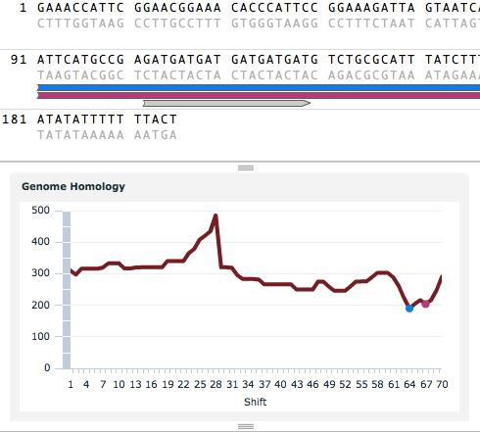
Merlin
Sequence viewing
Oligo optimization
Genome-to-oligo
Oligo-to-oligo

Slide 11
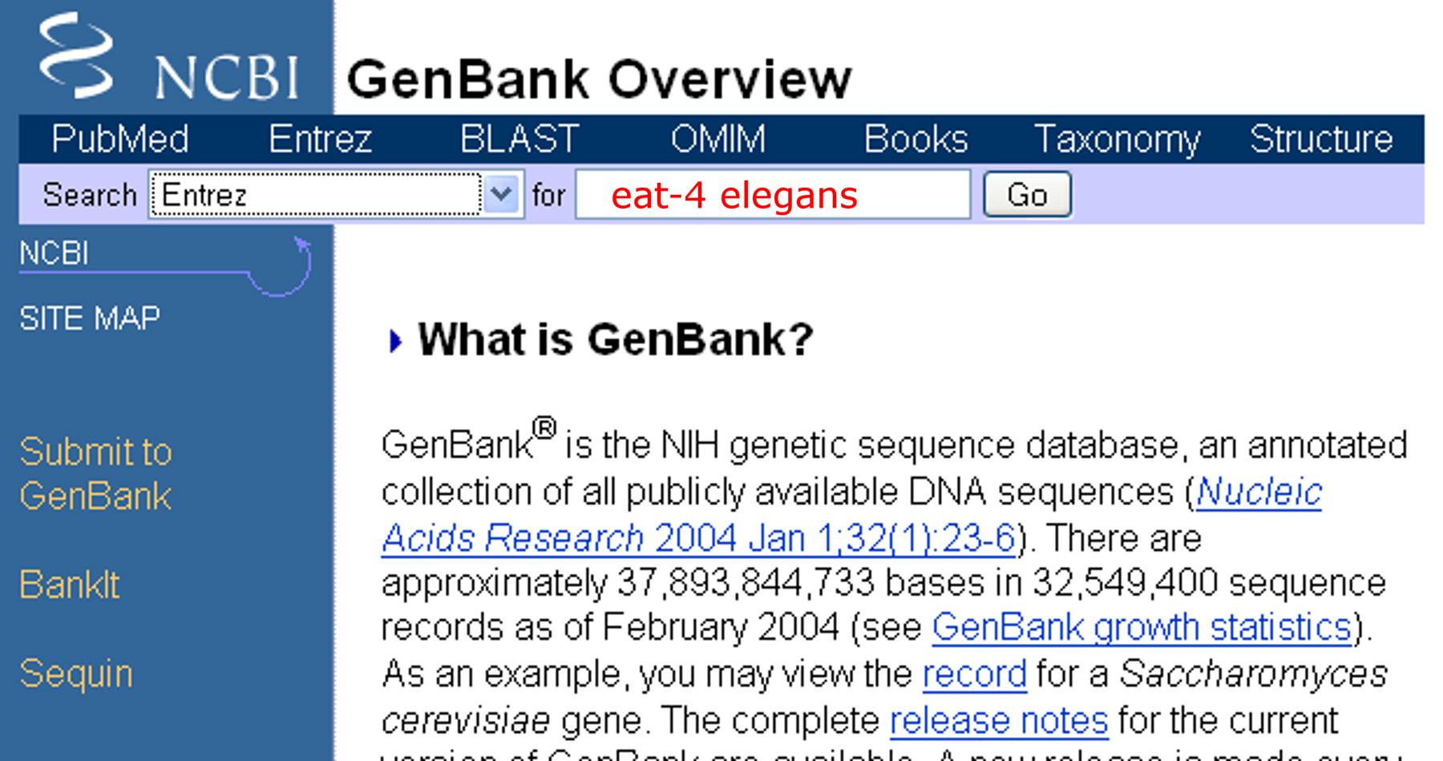
GenBank

Slide 12
Representing Sequences
Sequence
...ATCGA...GGCTA...ATTCA...GCTAA...

Slide 13

Annotating with Features
Sequence
...ATCGA...GGCTA...ATTCA...GCTAA...
Annotation
Feature

Slide 14
Hierarchical, Modular Annotation
Sequence
...ATCGA...GGCTA...ATTCA...GCTAA...
Annotation
ATCGA...GGCTA...ATTCA...GCTAA
Feature

Slide 15

Hierarchical, Modular Annotation
Sequence
...ATCGA...GGCTA...ATTCA...GCTAA...
Annotation
ATCGA...GGCTA...ATTCA...GCTAA
Feature

Slide 16
Hierarchical, Modular Annotation
Sequence
...ATCGA...GGCTA...ATTCA...GCTAA...
Annotation
ATCGA...GGCTA...ATTCA...GCTAA
ATCGA
GGCTA...ATTCA
GCTAA
Feature

Slide 17



Hierarchical, Modular Annotation
Sequence
...ATCGA...GGCTA...ATTCA...GCTAA...
Annotation
ATCGA...GGCTA...ATTCA...GCTAA
ATCGA
GGCTA...ATTCA
GCTAA
Feature

Slide 18




Visualizing Feature Roles
Sequence
...ATCGA...GGCTA...ATTCA...GCTAA...
Annotation
ATCGA...GGCTA...ATTCA...GCTAA
ATCGA
GGCTA...ATTCA
GCTAA
Feature

Slide 19
Non-Primary Structure
ATCGA...GGCTA...ATTCA...GCTAA
Sequence
ATCGA...GGCTA...ATTCA...GCTAA
ATCGA...GGCTA...ATTCA...GCTAA

Slide 20
Non-Primary Structure
Polynucleotide
ATCGA...GGCTA...ATTCA...GCTAA
Sequence
ATCGA...GGCTA...ATTCA...GCTAA
ATCGA...GGCTA...ATTCA...GCTAA

Slide 21
Sequence Editing and Optimization
Clotho provides schemas for representing
Sequences
Hierarchical, modular annotation
Features and their functional roles
Non-primary sequence structure

Slide 22










Phoenix
Functional decomposition
Repressilator
G
P
B
Transc. Unit
Transc. Unit
Transc. Unit
Expressor
Expressee
Expressor
Expressee
Expressor
Expressee

Slide 23









Phoenix
Functional decomposition
Test construct generation
G
P
B

Slide 24

Phoenix
Functional decomposition
Test construct generation
Model
fitting
G
P
B

Slide 25
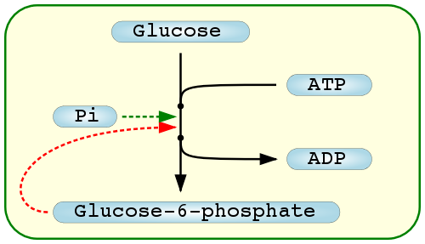
Systems Biology Markup Language

Slide 26
Functional Modules
Module
Toggle Switch

Slide 27
Functional Hierarchy
Module
Toggle Switch
Transcriptional Unit
Transcriptional Unit

Slide 28




Grouping Features into Modules
Module
Toggle Switch
Feature
Transcriptional Unit
Transcriptional Unit

Slide 29
Influences Between Features
Module
Influence
Toggle Switch
Feature
Transcriptional Unit
Transcriptional Unit

Slide 30
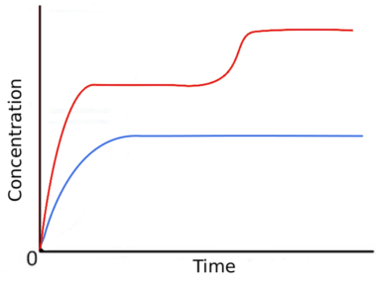
Associating Mathematical Models
Model
Module
Influence
Toggle Switch
Feature

Slide 31
Linking Function and Assembly
Biodesign
Module
Transcriptional Unit
Part

Slide 32
Parts Put Sequences Together
...ATCGA...GGCTA...GCTAA...
Part
Sequence

Slide 33
Parts Lack Explicit Function
...ATCGA...GGCTA...GCTAA...
Part
Sequence

Slide 34
Assembling Composite Part
...ATCGA...GGCTA...GCTAA...
Assembly
Part
Sequence

Slide 35
Assembling Composite Part
...ATCGA...GGCTA...GCTAA...
Assembly
Part
...ATCGA...
...GCTAA...
Sequence
...GGCTA...

Slide 36
Part Formats
...ATCGA...GGCTA...GCTAA...
Assembly
Part
...ATCGA...
...GCTAA...
Format
Sequence
...GGCTA...

Slide 37
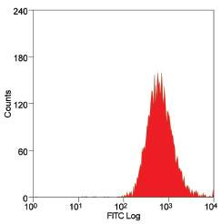
Storing Sample Data
SampleData

Slide 38
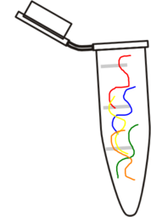
Tracking Samples
SampleData
Sample

Slide 39
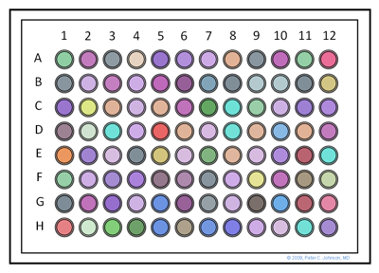
Tracking Samples
SampleData
Sample

Slide 40
Defining Sample Contents
SampleData
Sample
Biodesign
Transcriptional Unit

Slide 41
Model Fitting and Exp. Planning
Clotho provides schemas for representing
Functional hierarchies of modules, features, and influences
Parts to assemble sequences
Biodesigns to link separate concerns
Samples and data collected on them

Slide 42
Statistical Design of Experiments
Temperature
Low
High
Low pH, Low T
 | High pH, High T
Low pH, High T
Low
pH
High pH, Low T
High

Slide 43
Statistical Design of Experiments
Temperature
Low
High
Low pH, High T
Low
pH
High pH, Low T
High

Slide 44
Double Dutch
Level clustering
Low
High
Low
High

Slide 45
Double Dutch
Level clustering
120 REU
1400 REU
120 REU
1400 REU

Slide 46



Double Dutch
Level clustering
Level assignment

Slide 47
Double Dutch
Level clustering
Level assignment

Slide 48
Double Dutch
Level clustering
Level assignment
Template upload

Slide 49


Excel and JMP

Slide 50
Factorial Design
Factorial Design
Factor
Factor A
Factor B

Slide 51
Factorial Design
Factorial Design
Variable
Factor
Factor A
Factor B
Transcription Strength

Slide 52
Factorial Design
Factorial Design
Variable
Factor
Factor A
Factor B
Transcription Strength
Level
Level A1
Level A2
Level B1
Level B2

Slide 53
Factorial Design
Factorial Design
Variable
Parameter
Factor
Factor A
Factor B
Transcription Strength
Level
Level A1
Level A2
Level B1
Level B2
178 REU
1035 REU
123 REU
1189 REU

Slide 54
Fractional Factorial Design
Factorial Design
Experimental Condition
Parameter
Factor A
Factor B
Transcription Strength
Level A1
Level A2
Level B1
Level B2
178 REU
1035 REU
123 REU
1189 REU

Slide 55
Fractional Factorial Design
Factorial Design
Experimental Condition
Parameter
Factor A
Factor B
Transcription Strength
Level A1
Level A2
Level B1
Level B2
178 REU
1035 REU
123 REU
1189 REU

Slide 56
Fractional Factorial Design
Factorial Design
Experimental Condition
Parameter
Factor A
Factor B
Transcription Strength
Level A1
Level A2
Level B1
Level B2
178 REU
1035 REU
123 REU
1189 REU

Slide 57
Qual. Function and Performance
Parameter
178 REU
1035 REU
Transcription
Transcription
Biodesign
Module

Slide 58
Mapping Exp. Design to Biodesign
Factor
Biodesign
Factor A
Expression

Slide 59
Mapping Exp. Design to Biodesign
Factor
Level
Level A1
Transcription
Biodesign
Factor A
Expression
Level A2
Transcription

Slide 60
Validation via Common Parameters
Factor
Level
Level A1
178 REU
Transcription
Biodesign
Factor A
Expression
Level A2
1035 REU
Parameter
Transcription

Slide 61
Inference of Composite Biodesigns
Factorial Design
Experimental Condition
Parameter
Factor A
Factor B
Transcription Strength
Level A1
Level A2
Level B1
Level B2
178 REU
1035 REU
123 REU
1189 REU

Slide 62
Inference of Composite Biodesigns
Factorial Design
Experimental Condition
Parameter
Pathway
Pathway

Slide 63
Statistical Design of Experiments
Clotho provides schemas for representing
Factors and levels of factorial designs
Variables, parameters, and experimental conditions

Slide 64

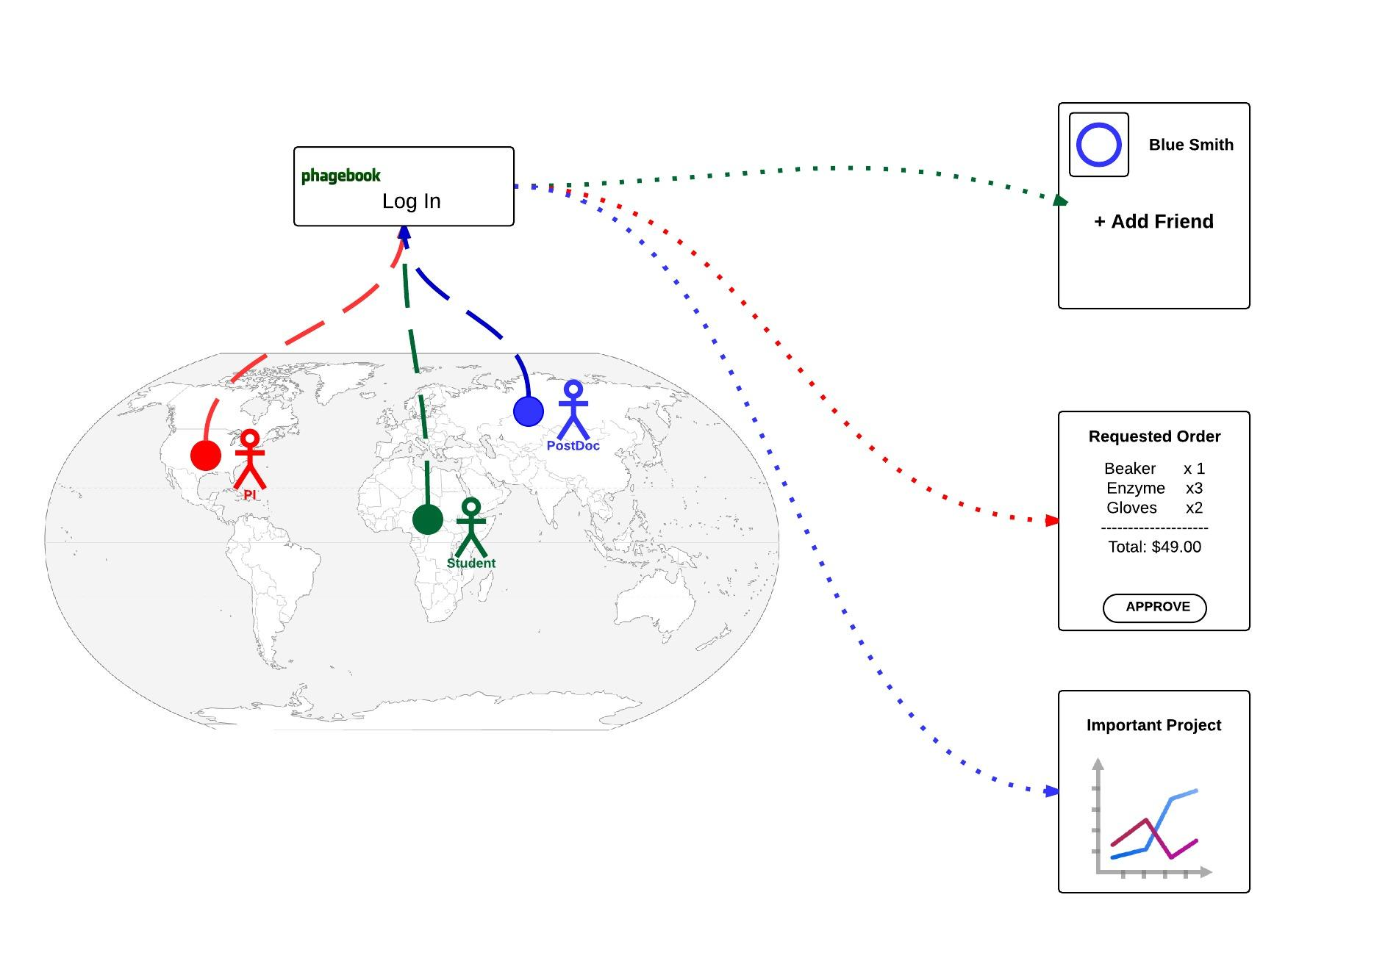

Slide 65
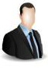
Project Docs and Networking
Person

Slide 66
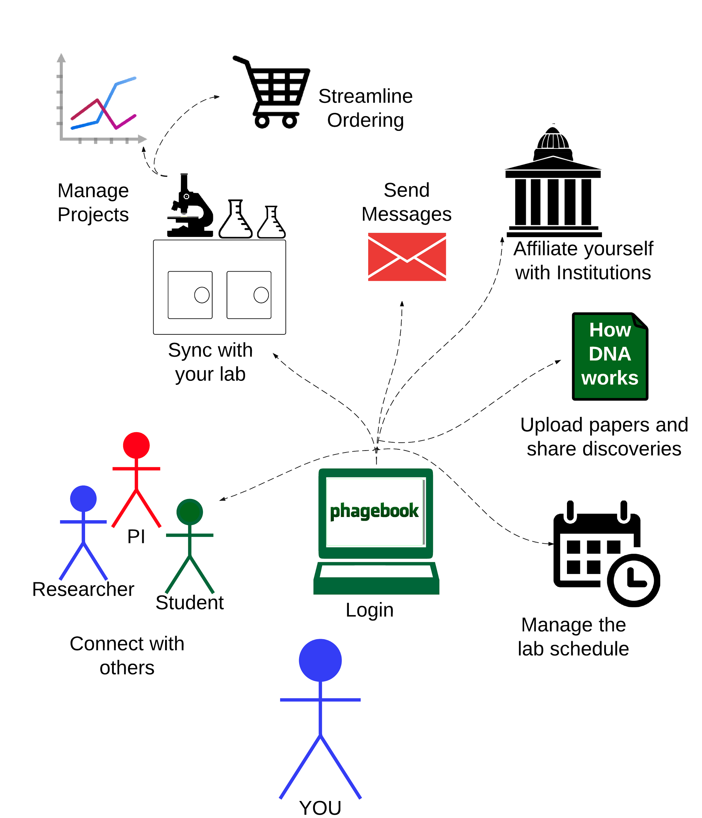
Project Docs and Networking
Institution
Person
Lab

Slide 67
Project Docs and Networking
Institution
Person
Lab
Project

Slide 68
Project Docs and Networking
Institution
Person
Order
Lab
Project

Slide 69
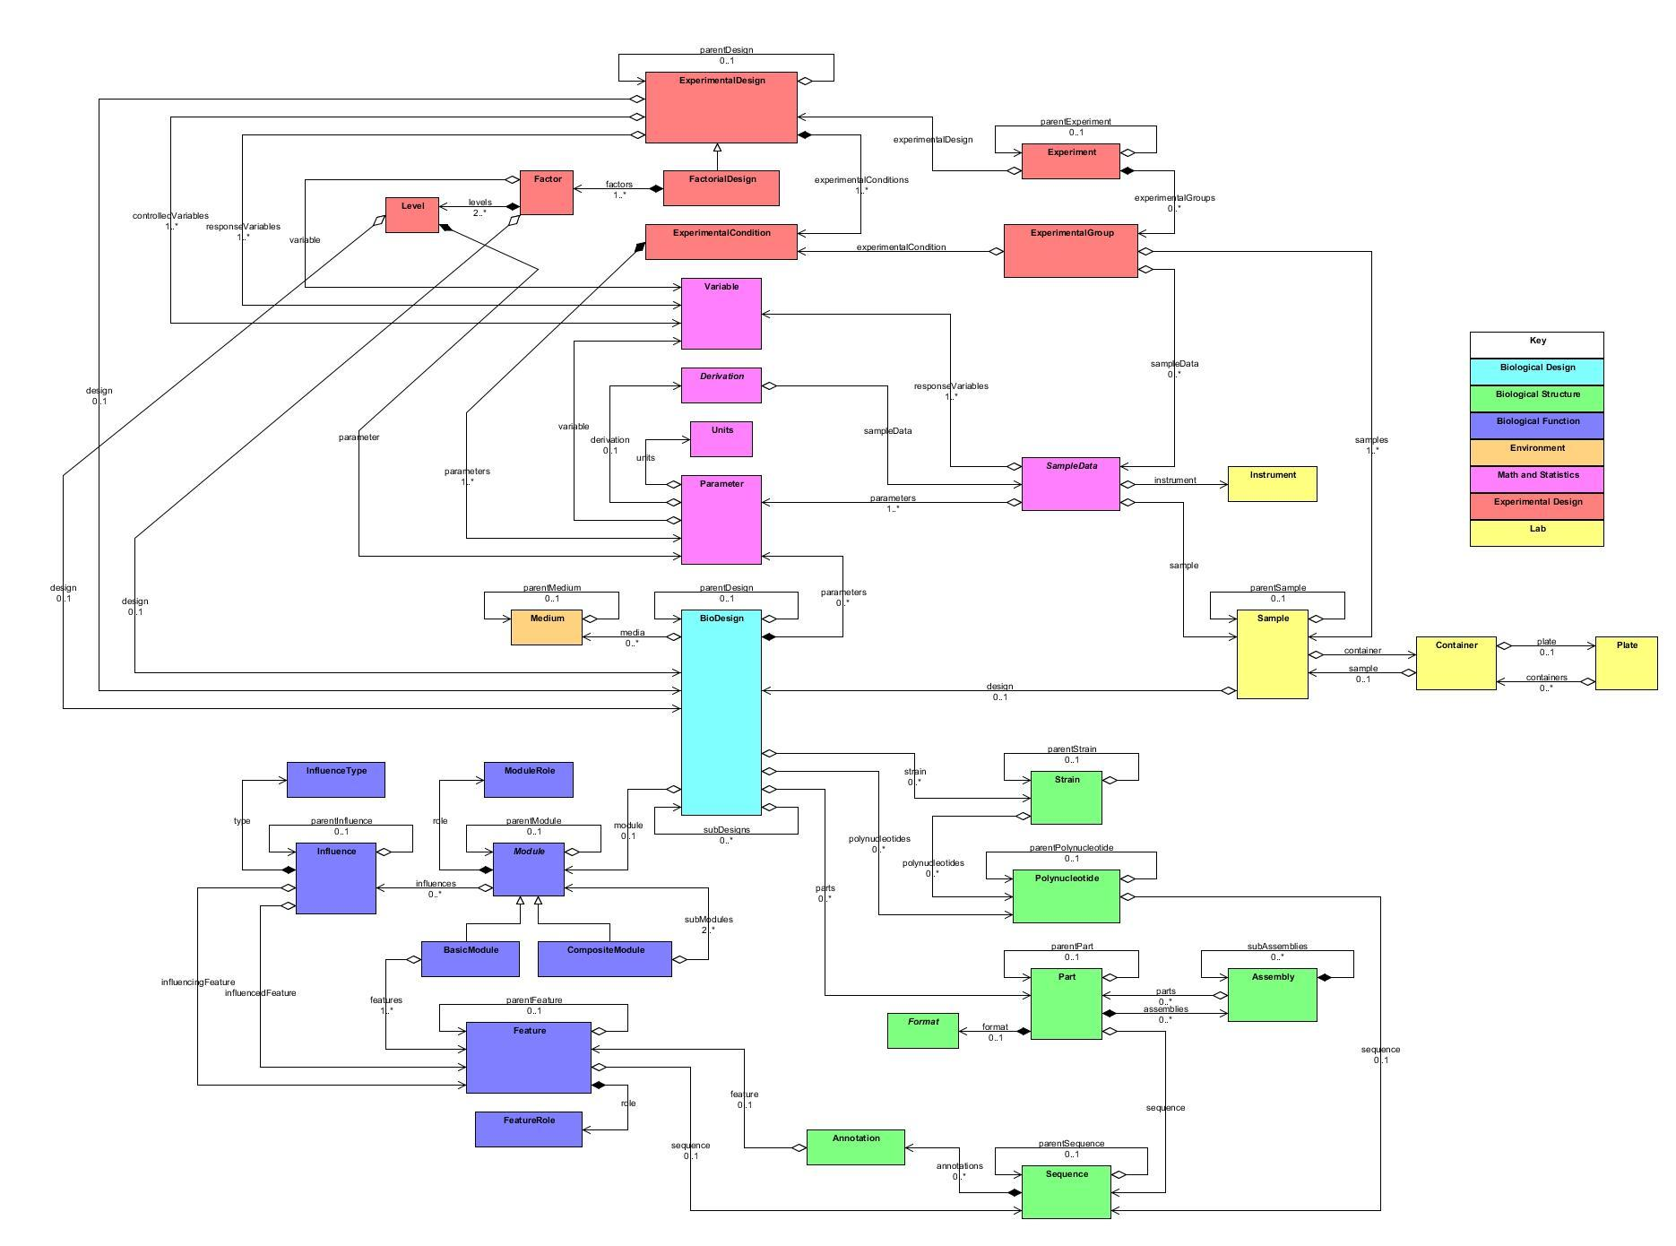
Clotho Object Model

Slide 70
Summary
Clotho provides schemas for representing
Structure and function of biological designs
Lab records
Experimental designs
Math and statistics

Slide 71
Summary
Clotho schemas can applied to a variety of applications, including
Sequence editing and optimization
Model fitting and experimental planning
Statistical design of experiments
Project documentation and networking

Slide 72
Conclusion
Clotho schemas provide a basic, extensible object model to kickstart the development of applications for synthetic biology and make it easier to persist data across different projects.

Slide 73

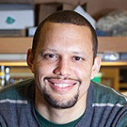




Acknowledgements
National Science Foundation Grant #1147158
Rafik B. Hariri Institute for Computing and Computational Science & Engineering
Azer Bestavros
Linda Grosser
Lauren Dupee
Densmore Lab
Douglas
Densmore
Stephanie
Paige
Prashant
Vaidyanathan
Anderson Lab
J. Christopher
Anderson
Bill
Cao
Mina
Li
Phagebook Team

